Slide 1
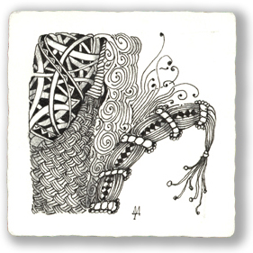
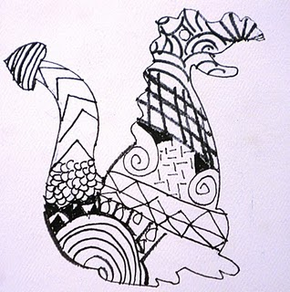
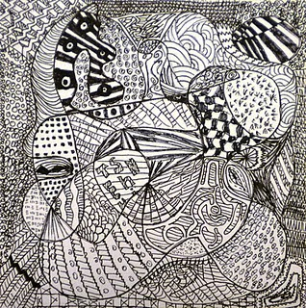
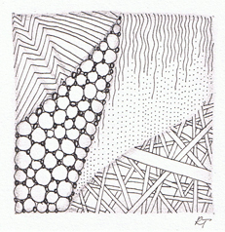
ZeNTANGLES…
…are all the RAGE right now!
K. Silvestri

Slide 2
Zentangle artists typically make their designs on small trading cards.
But you can make yours any size that you wish!

Slide 3
What is it?
Zentangle is an easy to learn method of creating beautiful images from repetitive patterns.
It is a fascinating new art form that is fun and relaxing.
It increases focus and creativity.
Zentangle provides artistic satisfaction and an increased sense of personal well being.
Zentangle is enjoyed by a wide range of skills and ages and is used in many fields of interest.
http://gpa-art-room.wikispaces.com/Zentangles

Slide 4
You cannot fail to create a Zentangle.
That is because a Zentangle is meant to look like a Zentangle. It does not need to look like anything else and has no up or down.
http://gpa-art-room.wikispaces.com/Zentangles

Slide 5
How to Make a Zentangle http://www.wikihow.com/Make-a-Zentangle
Draw a border outlining the shape of your zentangle.
It is very common to use a square shape. 4 x4 square.
The shape is usually relatively small (about 3 inches wide) as most zentangles are drawn in one sitting.
Note: You DON’T have to start with a square! Start with a circle or a triangle or a blank picture from a photo album! Trace your hand and work with that! DO WHATEVER YOU WANT!

Slide 6
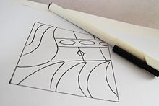
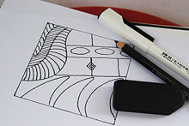
Draw strings.
Strings are lines that divide the shape into individual sections.
Fill one section with a repetitive pattern.
Don't spend too much time planning the pattern, just draw.

Slide 7
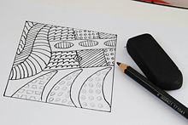
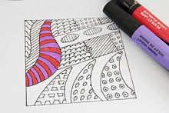
Repeat with each section. Change the pattern with each section.
Add color or shading as desired.

Slide 8
You try: Start with a STRING

Slide 9
Fill in the sections with patterns

Slide 10
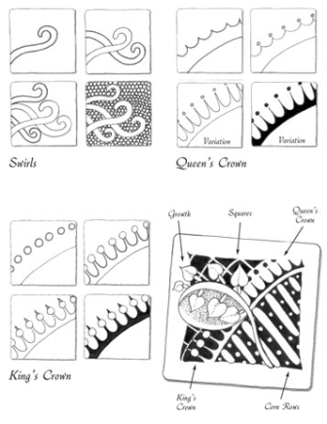
There are A LOT of different patterns.
You can google “zentangle patterns”…
…or find tangle patterns all around you!

Slide 11
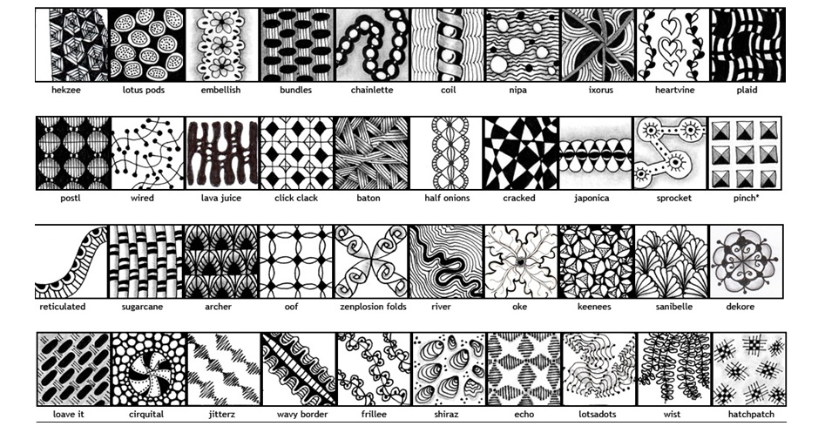
These are just a few patterns you can find at www.tanglepatterns.com

Slide 12
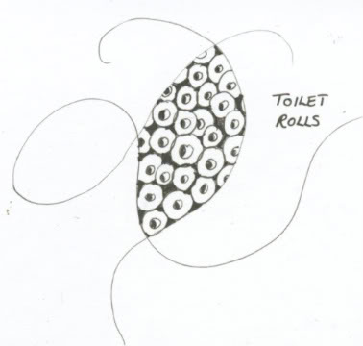
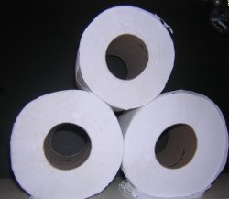
Zentangle Ideas - How to Find Them
In the bathroom!

Slide 13
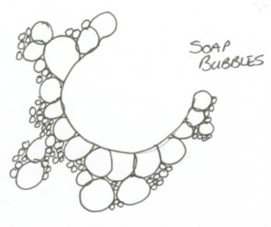
They are there - you just have to look

Slide 14
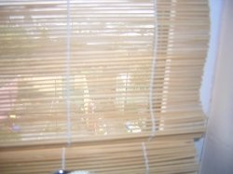
In the Living Room!

Slide 15
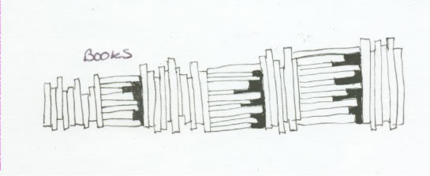
This 'book' Zentangle would make a great border, either around other patterns or around a page of text.

Slide 16
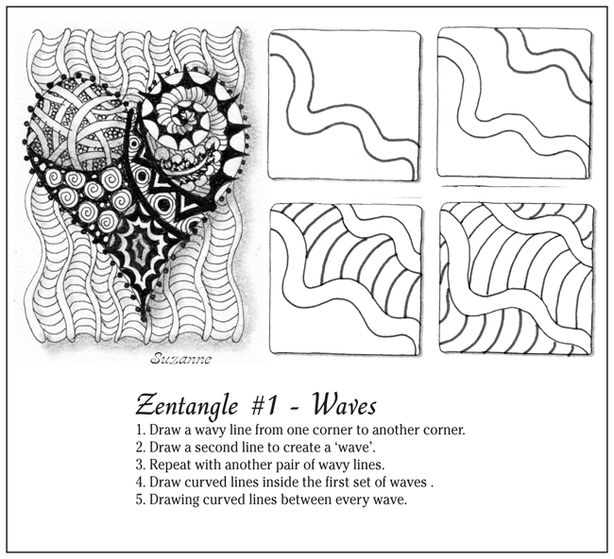
PATTERNS

Slide 17
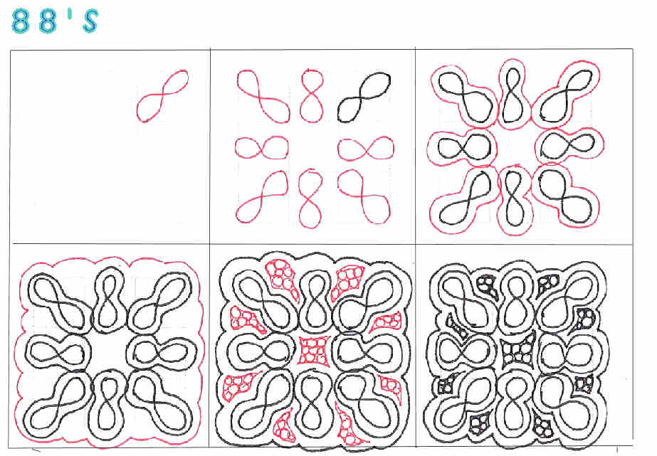
PATTERNS

Slide 18
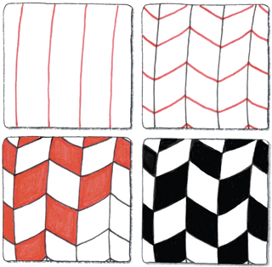
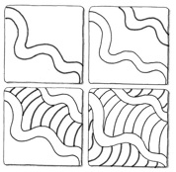
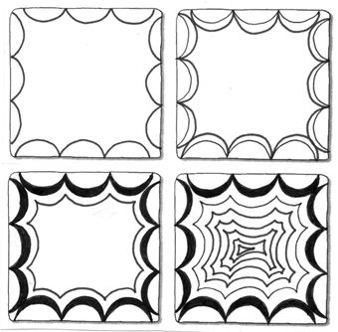

Slide 19
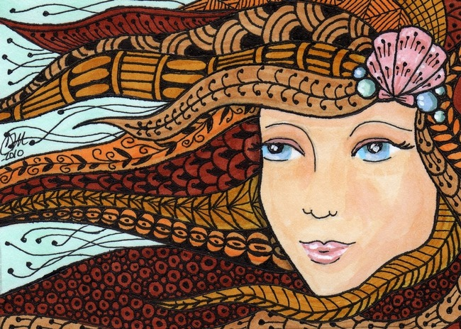
I just LOVE this one!

Slide 20
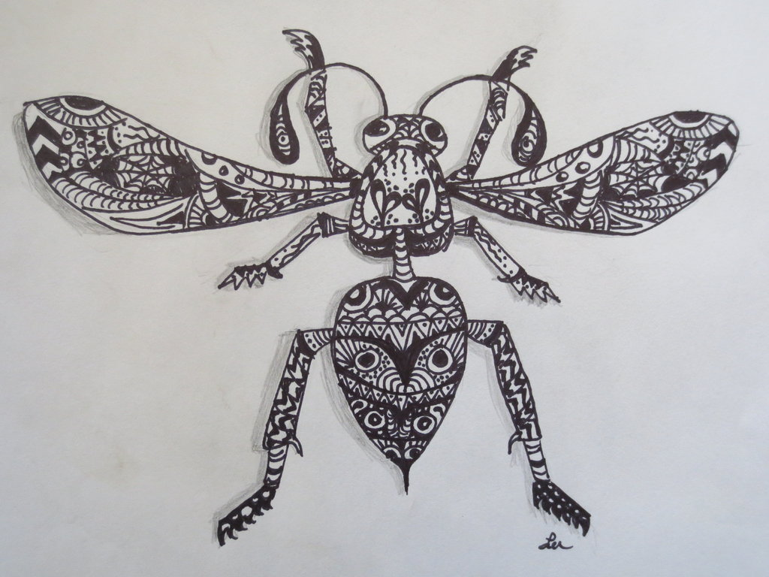
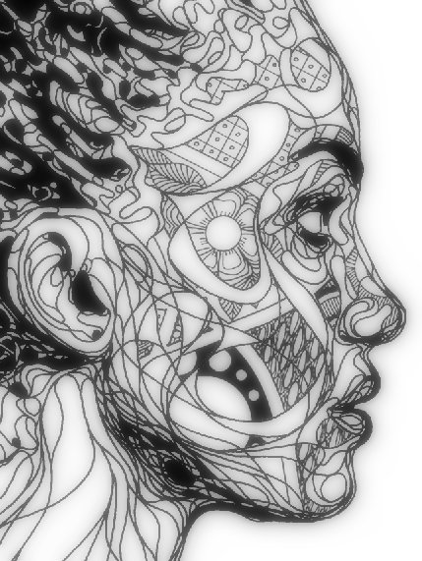
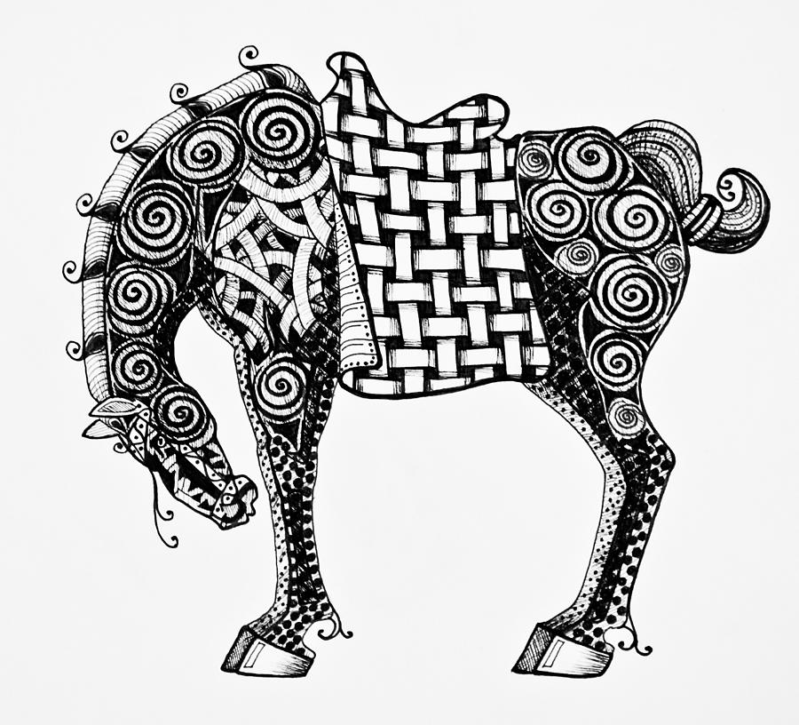

Slide 21
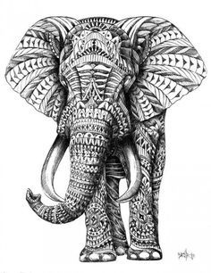
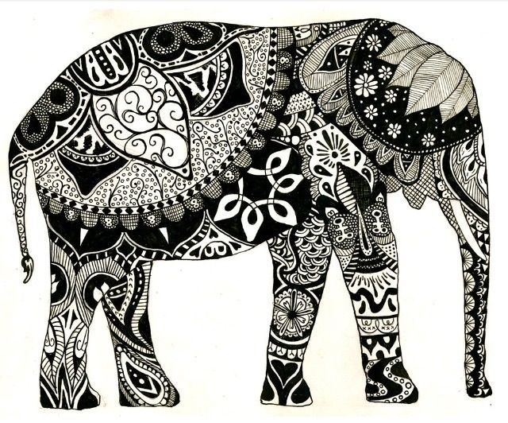

Slide 22
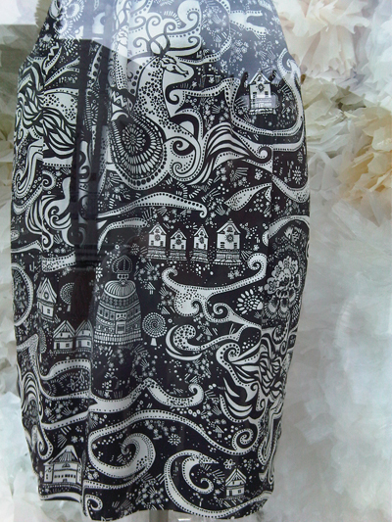
Zentangles are Everywhere
ON CLOTHING!

Slide 23
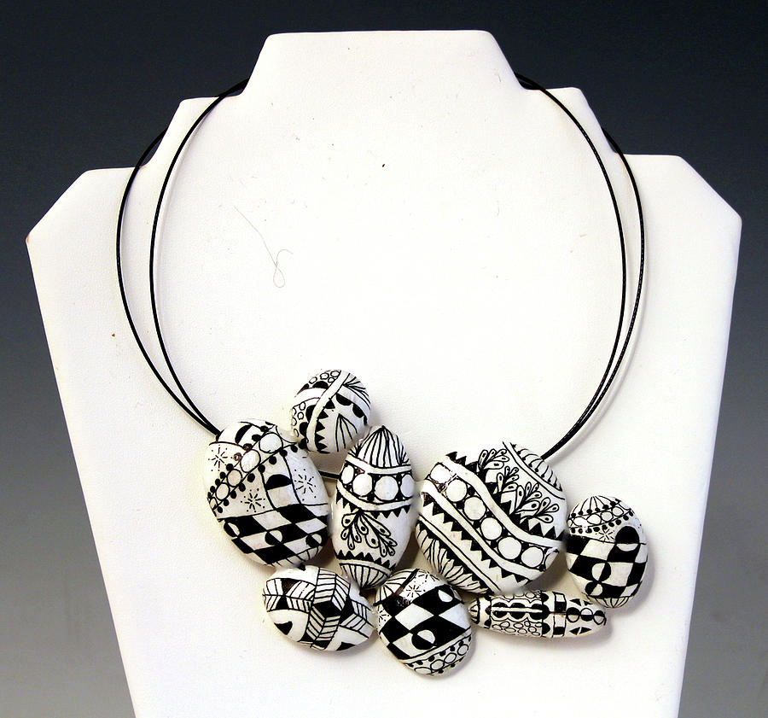

Slide 24
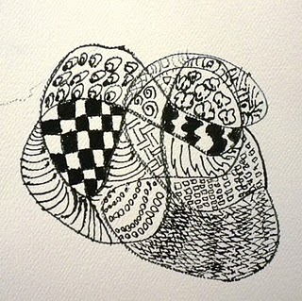
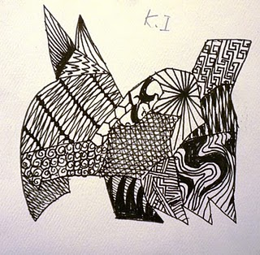
The Sky is the Limit!
You Can’t Mess Up a Zentangle….
….because they are already TANGLED!

Slide 25
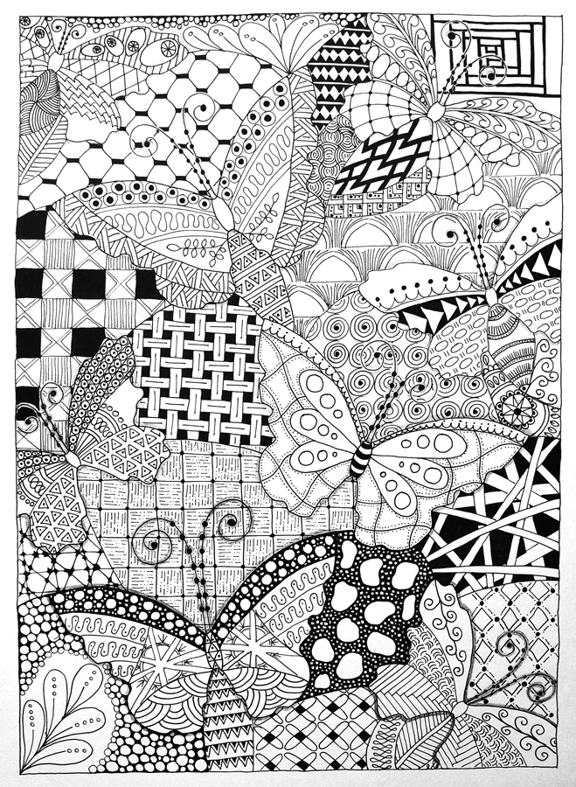
Zentangle Project
Option #1
The entire space is filled with Patterns
Image repeated at least 3 times
Image can be different sizes
Ex – small, medium & large
Has a ½ inch border
Do Not place Animal or Insect in the Center!

Slide 26
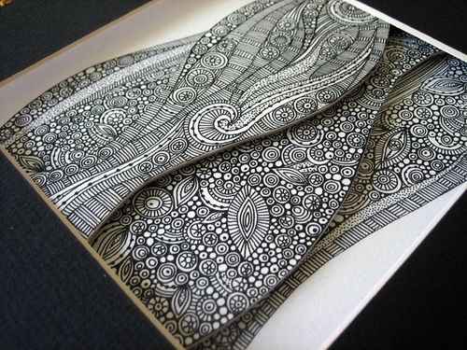
Zentangle Project
Option #2
Fill with Zentangles
Have at least 3 levels using foam core to pop off the board

Slide 27
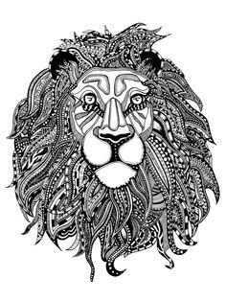
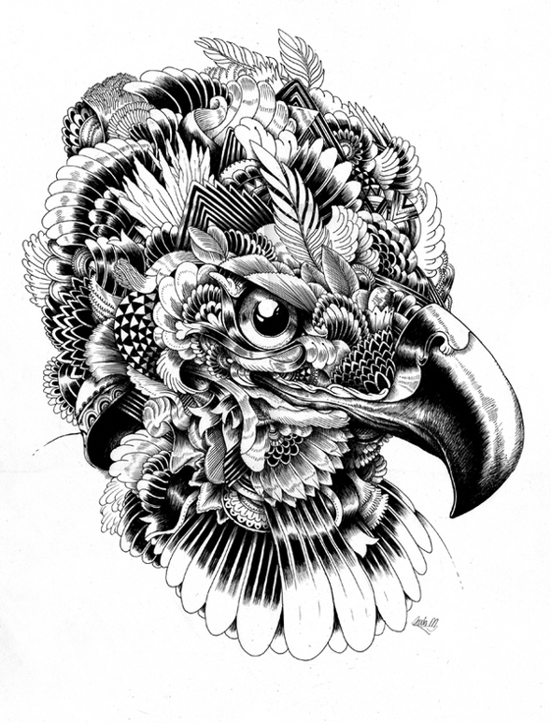
Zentangle Project
Option #3
*Choose an animal
*Create their fur or hair using different zentangles

Slide 28
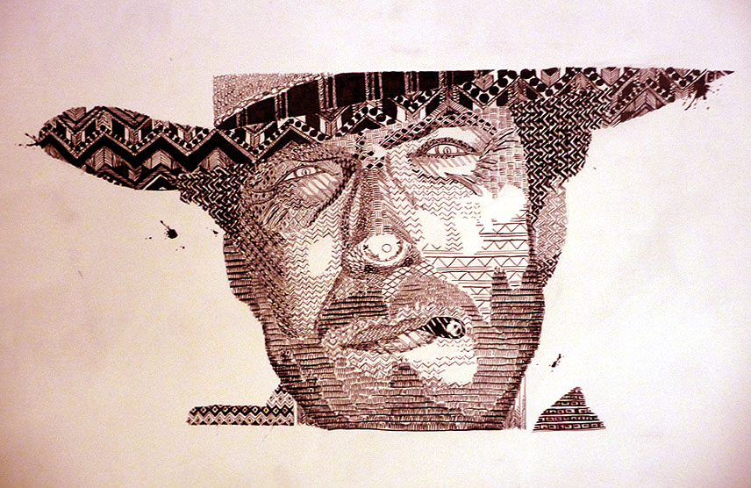

Slide 29
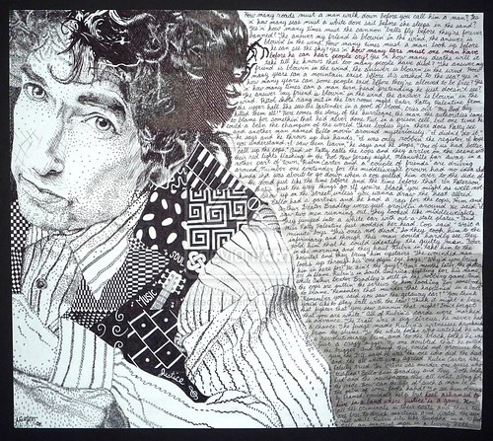

Slide 30
