Slide 1
Still Life Photography

Slide 2
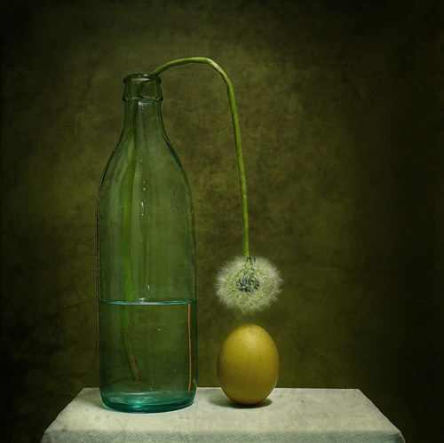
Fill the Frame
Your subject should be the only thing you see in the frame.
Remove any distractions or clutter from the background so that you have a clean, close up image.

Slide 3
Look for a good angle
Instead of shooting from your height, try shooting from the height of your subject.
Shoot from a variety of angles, not just straight on.

Slide 4
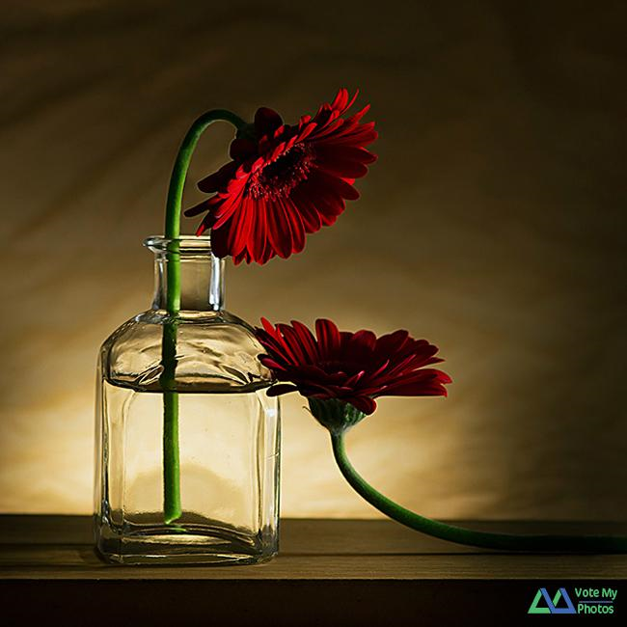
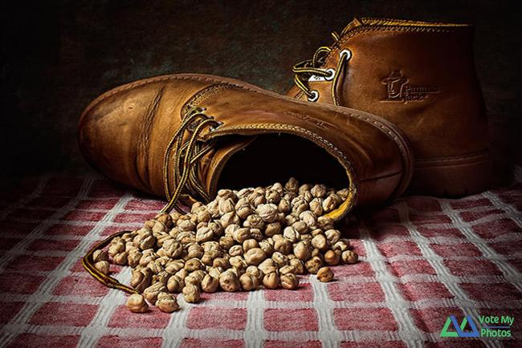
Composition
You have full control of how your objects are arranged. Take advantage!
It needs to be unified, interesting and fluid.
Consider “Composition rules”: Leading lines, Rule of Thirds and Simple & Close.

Slide 5
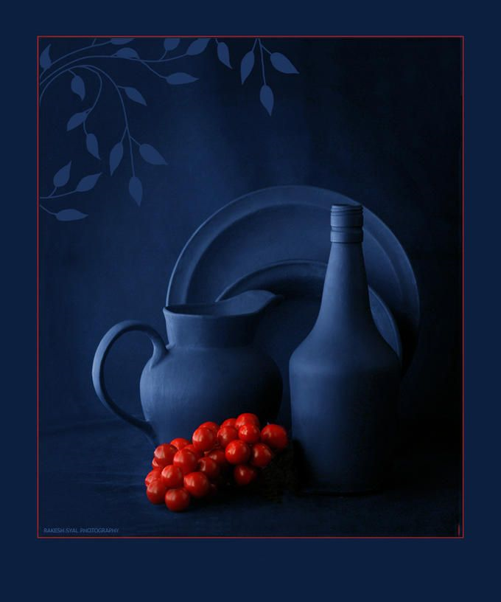
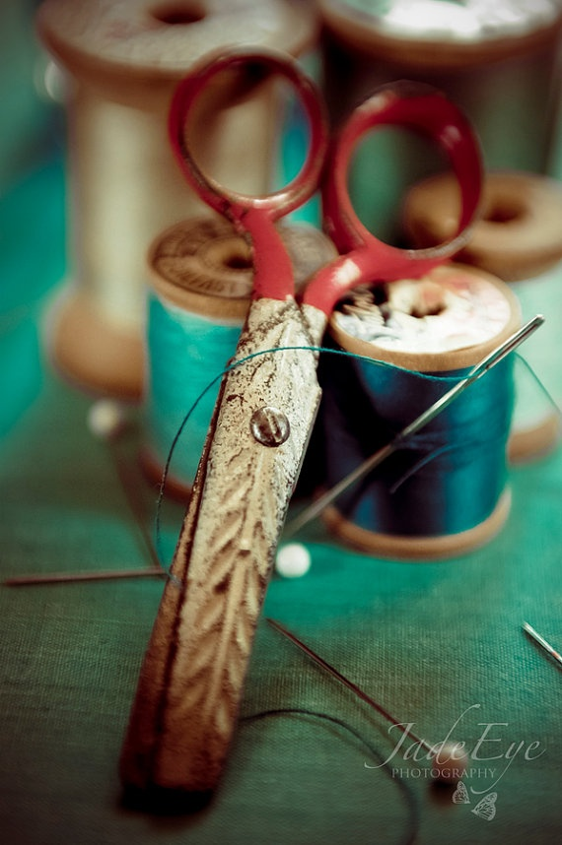
Subjects
The possibilities are literally endless!
Consider themes, color schemes, objects that juxtapose each other, things that have significant meaning to you.

Slide 6
Lighting
Next to composition, lighting is the most important part of still life photography.
Consider:
Where you want your light source coming from.
How intense you want your light to be.
Natural light vs lamps
How the light effects your objects.

Slide 7
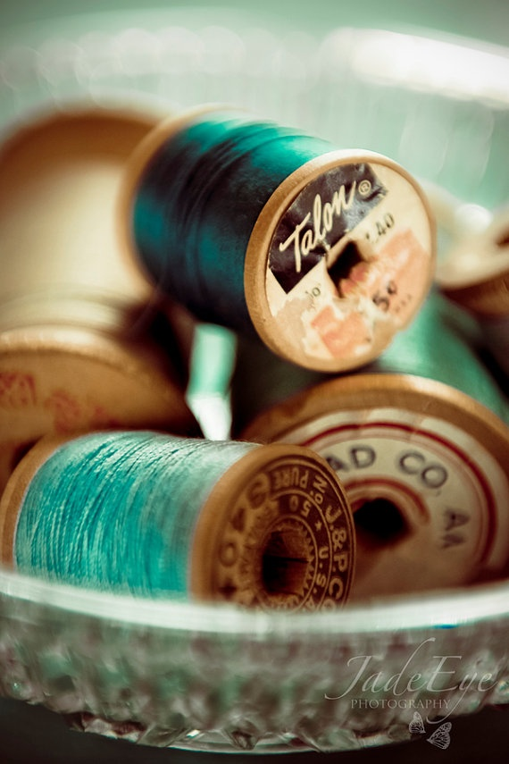
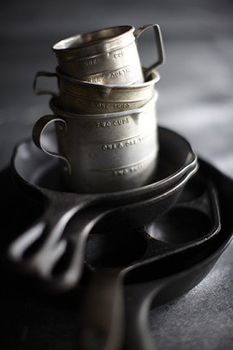
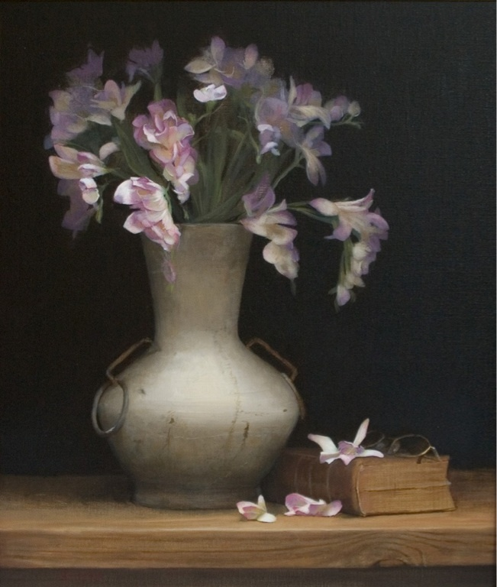
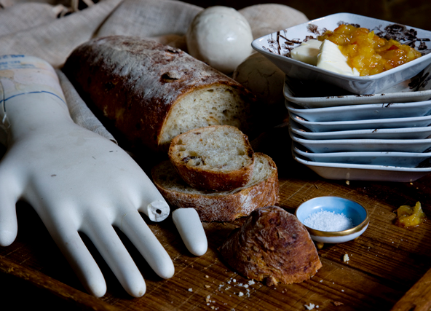
More Inspiration

Slide 8
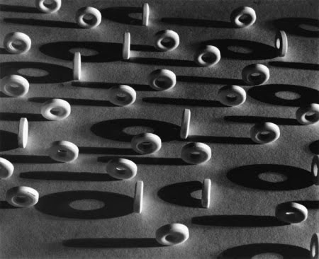
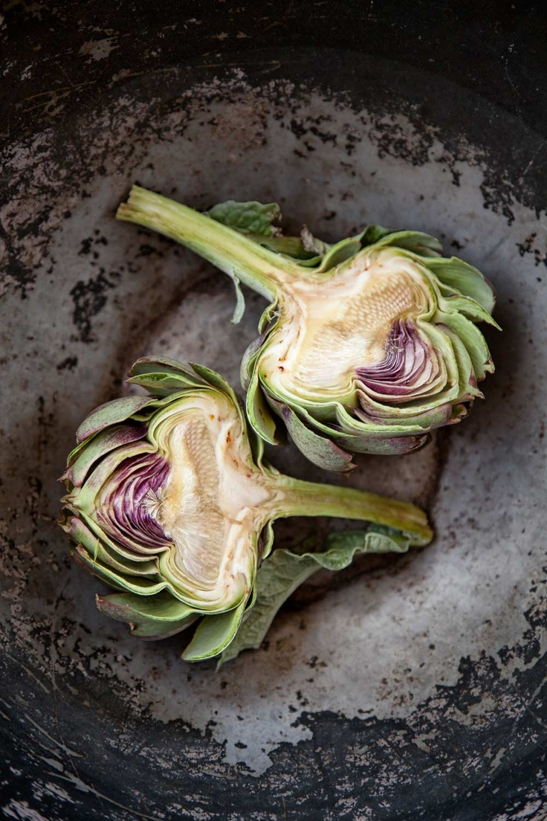
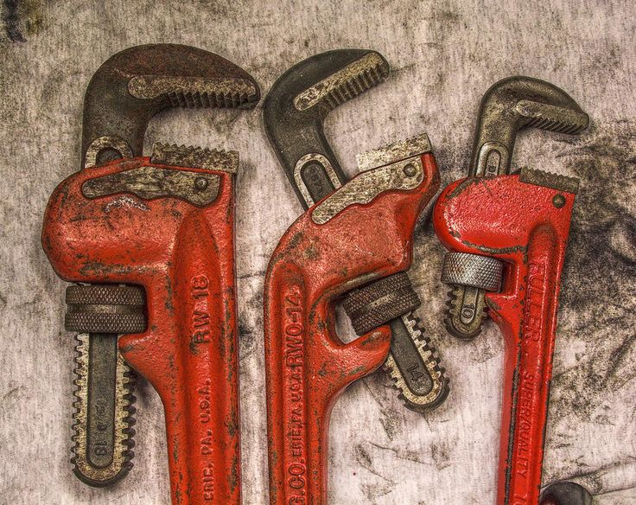

Slide 9
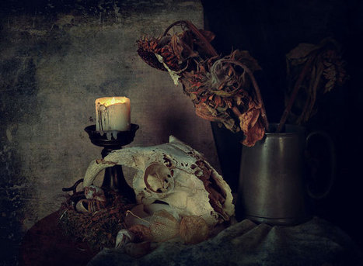
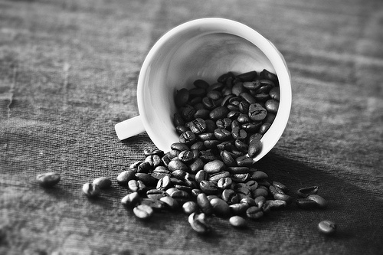
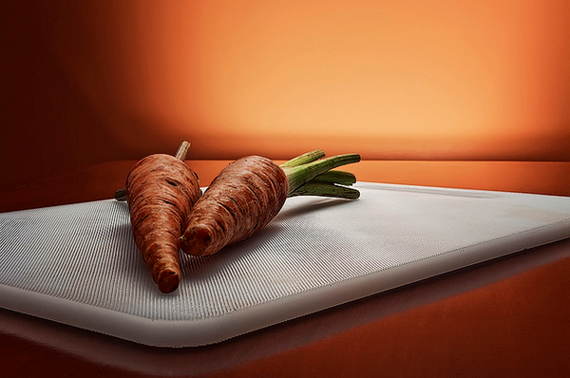

Slide 10
Now, It’s YOUR turn to create a Still Life!

Slide 11
Things to Remember & Consider:
Theme is important
Bring things in from home
You don’t need a lot of things to create an aesthetically pleasing photo
Objects can be related or juxtaposed.
Juxtapose: to place (different things) together in order to create an interesting effect or to show how they are the same or different
Lighting
Try different lighting natural vs. studio, soft light vs. hard light
NO Fake plants/flowers
NO Stuffed Animals

