Slide 1
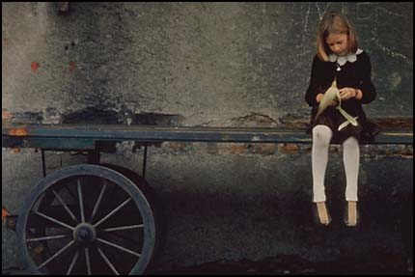
Composition Notes
What does a photo need & have?
________________________________________________________________________________________________________________________________________________________________________

Slide 2
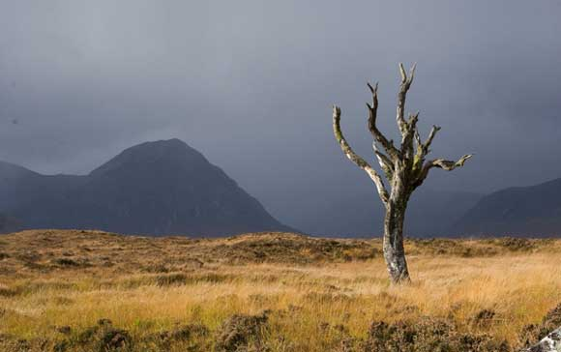
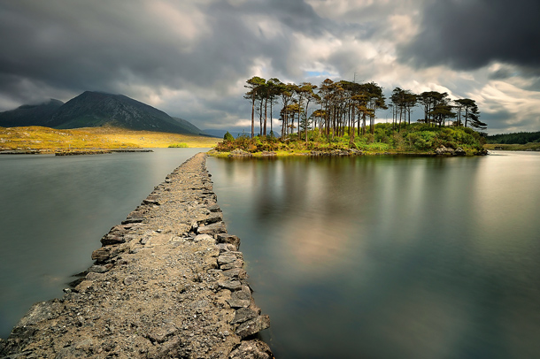
Rule of Thirds
Leading Lines
What is the Rule of Thirds? What does it look like? Can use the photo below.
Why is placing your subject on one of the points important?
__________________________________________________________________________________________________________________________________________________________________________________________________________________
What is “eye flow” and how can you use it in your photo?
____________________________________________________________________________________________________________________________________________________________________________________________________________________________________________________________________________________________________________

Slide 3
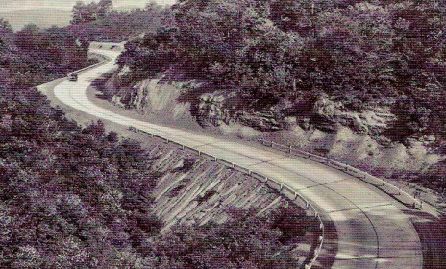
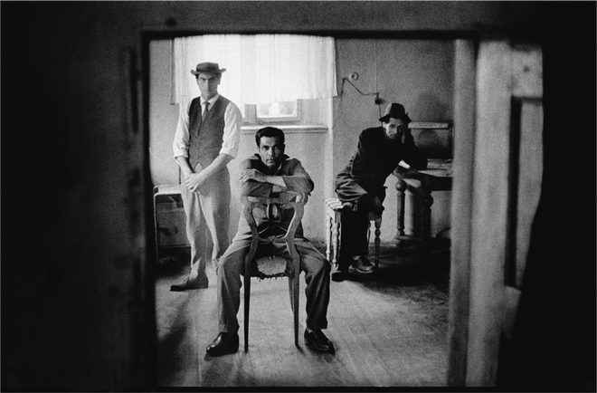
S-Curve
Geometric Shapes/Triangular
How is this a S-Curve composition? Can use the photo below to show.
__________________________________________________________________________________________
What does this composition help create in the photo?
______________________________________________________________________________________________________________________________________________________
How is this a Geometric/Triangular composition? Can use the photo below to show.
________________________________________________________________________________________________________________________
What does this composition help create in the photo?
__________________________________________________________________________________________

Slide 4
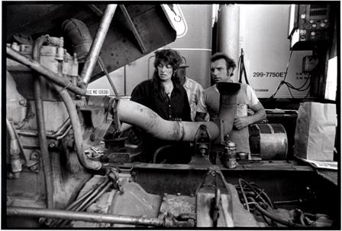
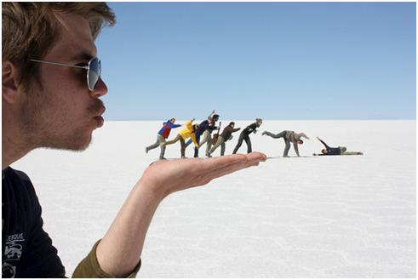
Congested
Scale/Trick Photography
What shouldn’t this composition have?
_________________________________
What is important to have when using this composition and why?
________________________________________________________________________________________________________________________________________________________________________________________________________________________________________________
What do you have to do to create a “trick” photo?
__________________________________________________________________________________________________________________________________________________________________________________________________________________________________________________________________________________________________________________________________________________________________

Slide 5
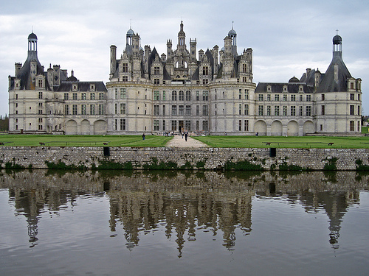
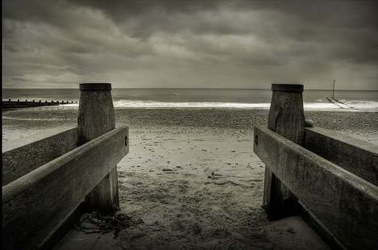
Symmetry/Symmetrical
Approximate Symmetry
What is Symmetry or Symmetrical?
___________________________________
How is the photo below symmetrical?
__________________________________________________________________________________________________________________________________________________________________________________________________________________
Why is the photo below NOT Symmetrical?
__________________________________________________________________________________________________________________________________________________________________________________________________________________

Slide 6
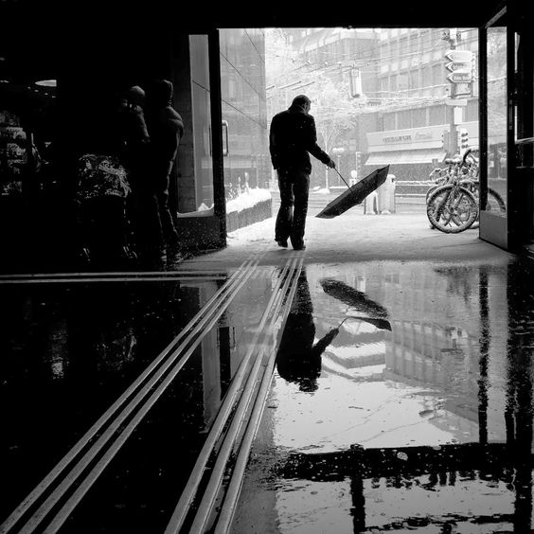
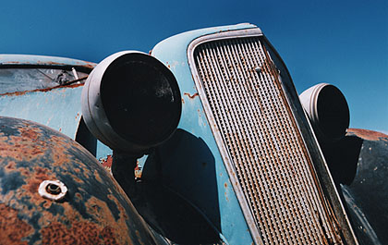
Framing
Fill the Frame
What can you use to frame your subject?
________________________________________________________________________________________________________________________________________________________________________________________________________________________________________________________________________________________________________________________________________________________________________
What is “fill the frame”?
______________________________________________________________________________________________________________________________________________________
How can it help you photo?
____________________________________________________________________________________________________________________________________________________________________________________

Slide 7
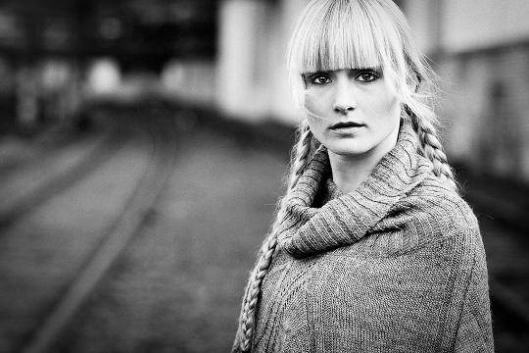
Centered
Selective Focus/Bokeh
Using center should be avoided, but what can you do to create interest when your subject is centered?
__________________________________________________________________________________________________________________________________________________________________________________________________________________________________________________________________________________________________________________________________________
What does Selective Focus or Bokeh mean?
___________________________________
Why would you use this technique in your photography?
______________________________________________________________________________________________________________________________________________________________________________________________________________________________________________________________________________

Slide 8
Horizontal Format/Cropping
Vertical Format/Cropping
What are the positives in the photo below, if any?
______________________________________________________________________________________________________________________________________________________
What are the negatives for the photo below, if any?
____________________________________________________________________________________________________________________________________________________________________________________
What are the positives for the photo below, if any?
______________________________________________________________________________________________________________________________________________________
What are the negatives for the photo below, if any?
_____________________________________________________________________________________________________________________________________________________________________________________________________

Slide 9
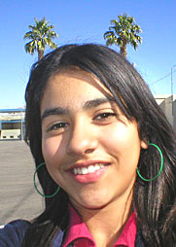
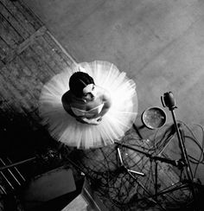
Viewpoints/Vantage Points
Avoid Merges
Why is it important to have take different viewpoints/vantage points of the same subject?
____________________________________________________________________________________________________________________________________________________________________________________
What are some things you can do to create different vantage points while you shoot?
____________________________________________________________________________________________________________________________________________________________________________________
What is a merge in a photograph and how can you avoid &/or correct it while shooting?
_____________________________________________________________________________________________________________________________________________________________________________________________________________________________________________________
What if you can’t fix the merge, what can you do to correct it?
____________________________________________________________________________________________________________________________________________________________________________________

Slide 10
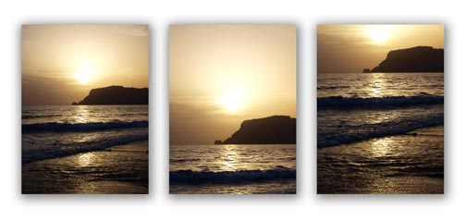
Horizon Line
What do you Remember/What will you try?
Where should you horizon line be in the photo and why?
__________________________________________________________________________________________________________________________________________________________________________________________________________________
Draw a X through the incorrect photo.
________________________
________________________
________________________
________________________
________________________
________________________
________________________
________________________
________________________
________________________
________________________
________________________
________________________
________________________

